Slide 1
Churn Rates of CodeFlix
By Kevin Beckerleg

Slide 2
Table of Contents
Codeflix Company Overview
Overall Churn rate by month
Churn rate comparison

Slide 3
Codeflix the Company
First we want to look at the SQL Table. We can get a brief idea by selecting all columns from the schema.
SELECT *
FROM subscriptions
LIMIT 5;
id | subscription_start | subscription_end | segment
1 | 2016-12-01 | 2017-02-01 | 87
2 | 2016-12-01 | 2017-01-24 | 87
3 | 2016-12-01 | 2017-03-07 | 87
4 | 2016-12-01 | 2017-02-12 | 87
5 | 2016-12-01 | 2017-03-09 | 87

Slide 4
Data range for to examine churn rate
MIN(subscription_start) | MAX (subscription_end)
2016-12-01 | 2017-03-31
We want to see the range of data the table spans.
It looks like it ranges from December 1st 2016 to March 31st 2017.
SELECT MIN(subscription_start), MAX (subscription_end)
FROM subscriptions

Slide 5
Breaking down the Months
WITH months as (SELECT '2017-01-01' as first_day, '2017-01-31' as last_day UNION SELECT '2017-02-01' as first_day, '2017-02-28' as last_day UNION SELECT '2017-03-01' as first_day, '2017-03-31' as last_day ) SELECT * FROM months;
To calculate the churn rate we need to create the periods of the churn, we can do this by creating a temporary table called Months.
first_day | last_day
2017-01-01 | 2017-01-31
2017-02-01 | 2017-02-28
2017-03-01 | 2017-03-31

Slide 6
Coding The Churn Rate
The Next two slides will show the creation of the table used to calculate the churn rate.
The first slide shows getting the active subscriptions separated out into columns.
The second shows getting the canceled subscriptions broken out into columns.

Slide 7
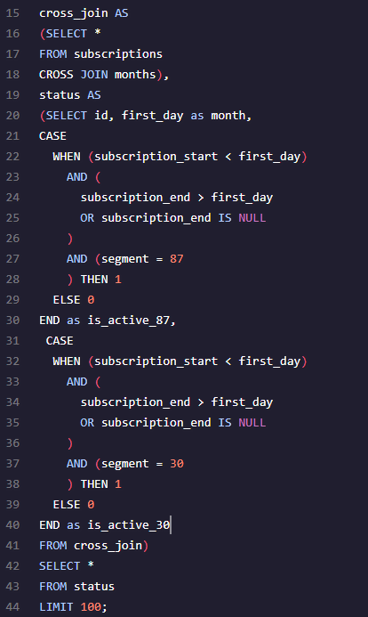
Creating our Churn Tables Part 1.
id | month | is_active_87 | is_active_30
1 | 2017-01-01 | 1 | 0
1 | 2017-02-01 | 0 | 0
1 | 2017-03-01 | 0 | 0
2 | 2017-01-01 | 1 | 0
2 | 2017-02-01 | 0 | 0
2 | 2017-03-01 | 0 | 0
3 | 2017-01-01 | 1 | 0

Slide 8
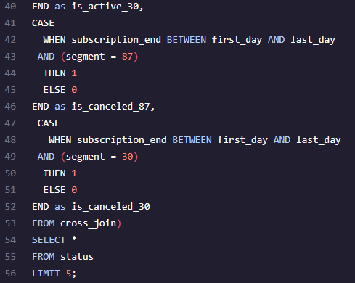
Calculating Churn Pt. 2
id | month | is_active_87 | is_active_30 | is_canceled_87 | is_canceled_30
1 | 2017-01-01 | 1 | 0 | 0 | 0
1 | 2017-02-01 | 0 | 0 | 1 | 0
1 | 2017-03-01 | 0 | 0 | 0 | 0
2 | 2017-01-01 | 1 | 0 | 1 | 0
2 | 2017-02-01 | 0 | 0 | 0 | 0

Slide 9
Calculating the Churn Rates
status_aggregate AS
(Select month,
Sum(is_active_87) as 'sum_active_87',
Sum(is_active_30) as 'sum_active_30',
Sum(is_canceled_87) as 'sum_canceled_87',
Sum(is_canceled_30) as 'sum_canceled_30'
FROM status
GROUP BY month)
SELECT month, 1.0 * status_aggregate.sum_canceled_87 / status_aggregate.sum_active_87 as churn_rate_87, 1.0 * status_aggregate.sum_canceled_30 / status_aggregate.sum_active_30 as churn_rate_30
FROM status_aggregate;
Finally we can calcute the churn rates.
month | churn_rate_87 | churn_rate_30
2017-01-01 | 0.251798561151079 | 0.0756013745704467
2017-02-01 | 0.32034632034632 | 0.0733590733590734
2017-03-01 | 0.485875706214689 | 0.11731843575419

